Slide 1
AgriData Explorer: Understanding Indian agriculture with EDA
NAVEENKUMAR SIVAKUMAR

Slide 2
🌾 Key Problem Statement :
The core problem is the difficulty stakeholders face in accessing, analyzing, and making informed decisions based on fragmented, complex, and poorly managed agricultural data in India.
This results in:
Fragmented Data: Agricultural data is scattered across different states, districts, and sources, making a unified view impossible.
Lack of Easy Access: Farmers, policymakers, and researchers struggle to retrieve the necessary data efficiently.
Complexity & Difficult Analysis: The sheer volume and complexity of the data make it hard for users to derive meaningful insights, identify trends, and understand regional disparities.
Suboptimal Decision-Making: The lack of accessible, analyzed data hinders farmers' ability to optimize crop choices and prevents policymakers from effectively targeting areas for intervention.

Slide 3
📊 Project Goal and Solution Overview
The overarching goal is to integrate agricultural data from various Indian states and districts into a single, user-friendly data visualization platform to unlock actionable insights.
Key Solution Points:
Data Integration:
Integrate agricultural data from different states and districts into a centralized system.
Create a unified and comprehensive dataset for India's agricultural sector.
Core Data Focus:
Provide insights into key metrics such as crop production, yields, and areas under cultivation.
Visualization & Accessibility:
Develop a data visualization platform that makes the complex data easy to access and understand.
Enable users to identify trends, gaps, and regional disparities quickly.
Stakeholder Benefits:
Farmers: Optimize crop choices and farming practices based on regional data.
Policymakers: Assist in targeting areas for intervention (e.g., resource allocation, subsidy programs).
Researchers: Support in analyzing agricultural trends and understanding macro-level changes.

Slide 4
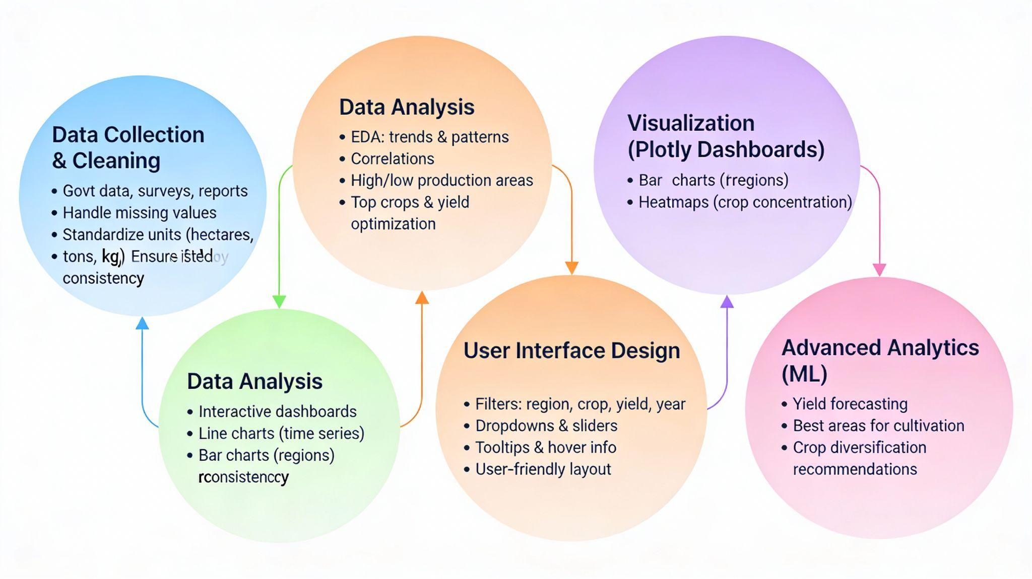

Slide 5
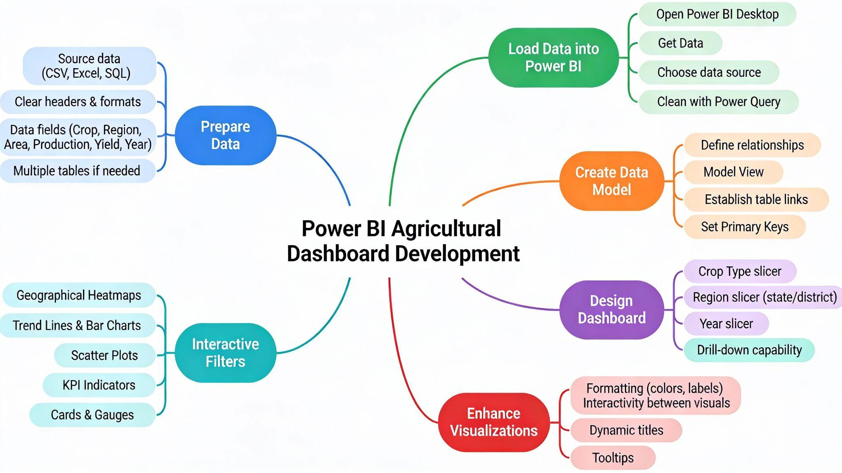

Slide 6
THANK YOU!!!

